Slide 1
Canvas
“To properly understand the big picture, everyone should fear becoming obsessed with one small section of truth.” ~ Xun Zi

Slide 2

Mission…
“In order to determine a way forward to improving testability, a holistic view of the architecture and its challenges needs to be drawn together. This should include many aspects of the system to prevent local optimisation.”

Slide 3

Objectives…
Learning Objectives:
Understand the impact of adjacent teams on the testability of an architecture
Understand the challenge of internal and external dependencies on the testability of an architecture
Recognise common pain points in each interface and layer of the architecture
Recommend remedial action in a time and effort sensitive manner

Slide 4
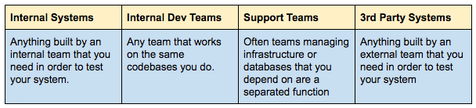
Adjacent Testability Targets
Your testability is affected by the systems and teams around you.
Four categories to measure the impact of adjacent testability
Handouts for teams and systems list adjacent parties.

Slide 5
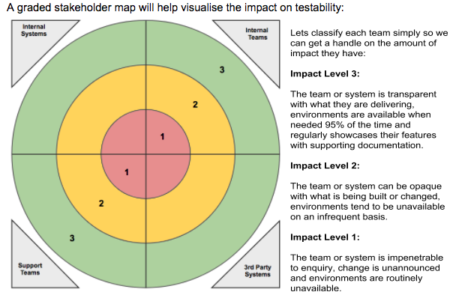
Adjacent Testability Targets
Draw the target as above
Add the teams and systems based on the impact on testability you think they have
Reflect back

Slide 6
System Dependencies
Huge testability impact
Especially those you don’t control
Deeper dive
Alternative view

Slide 7
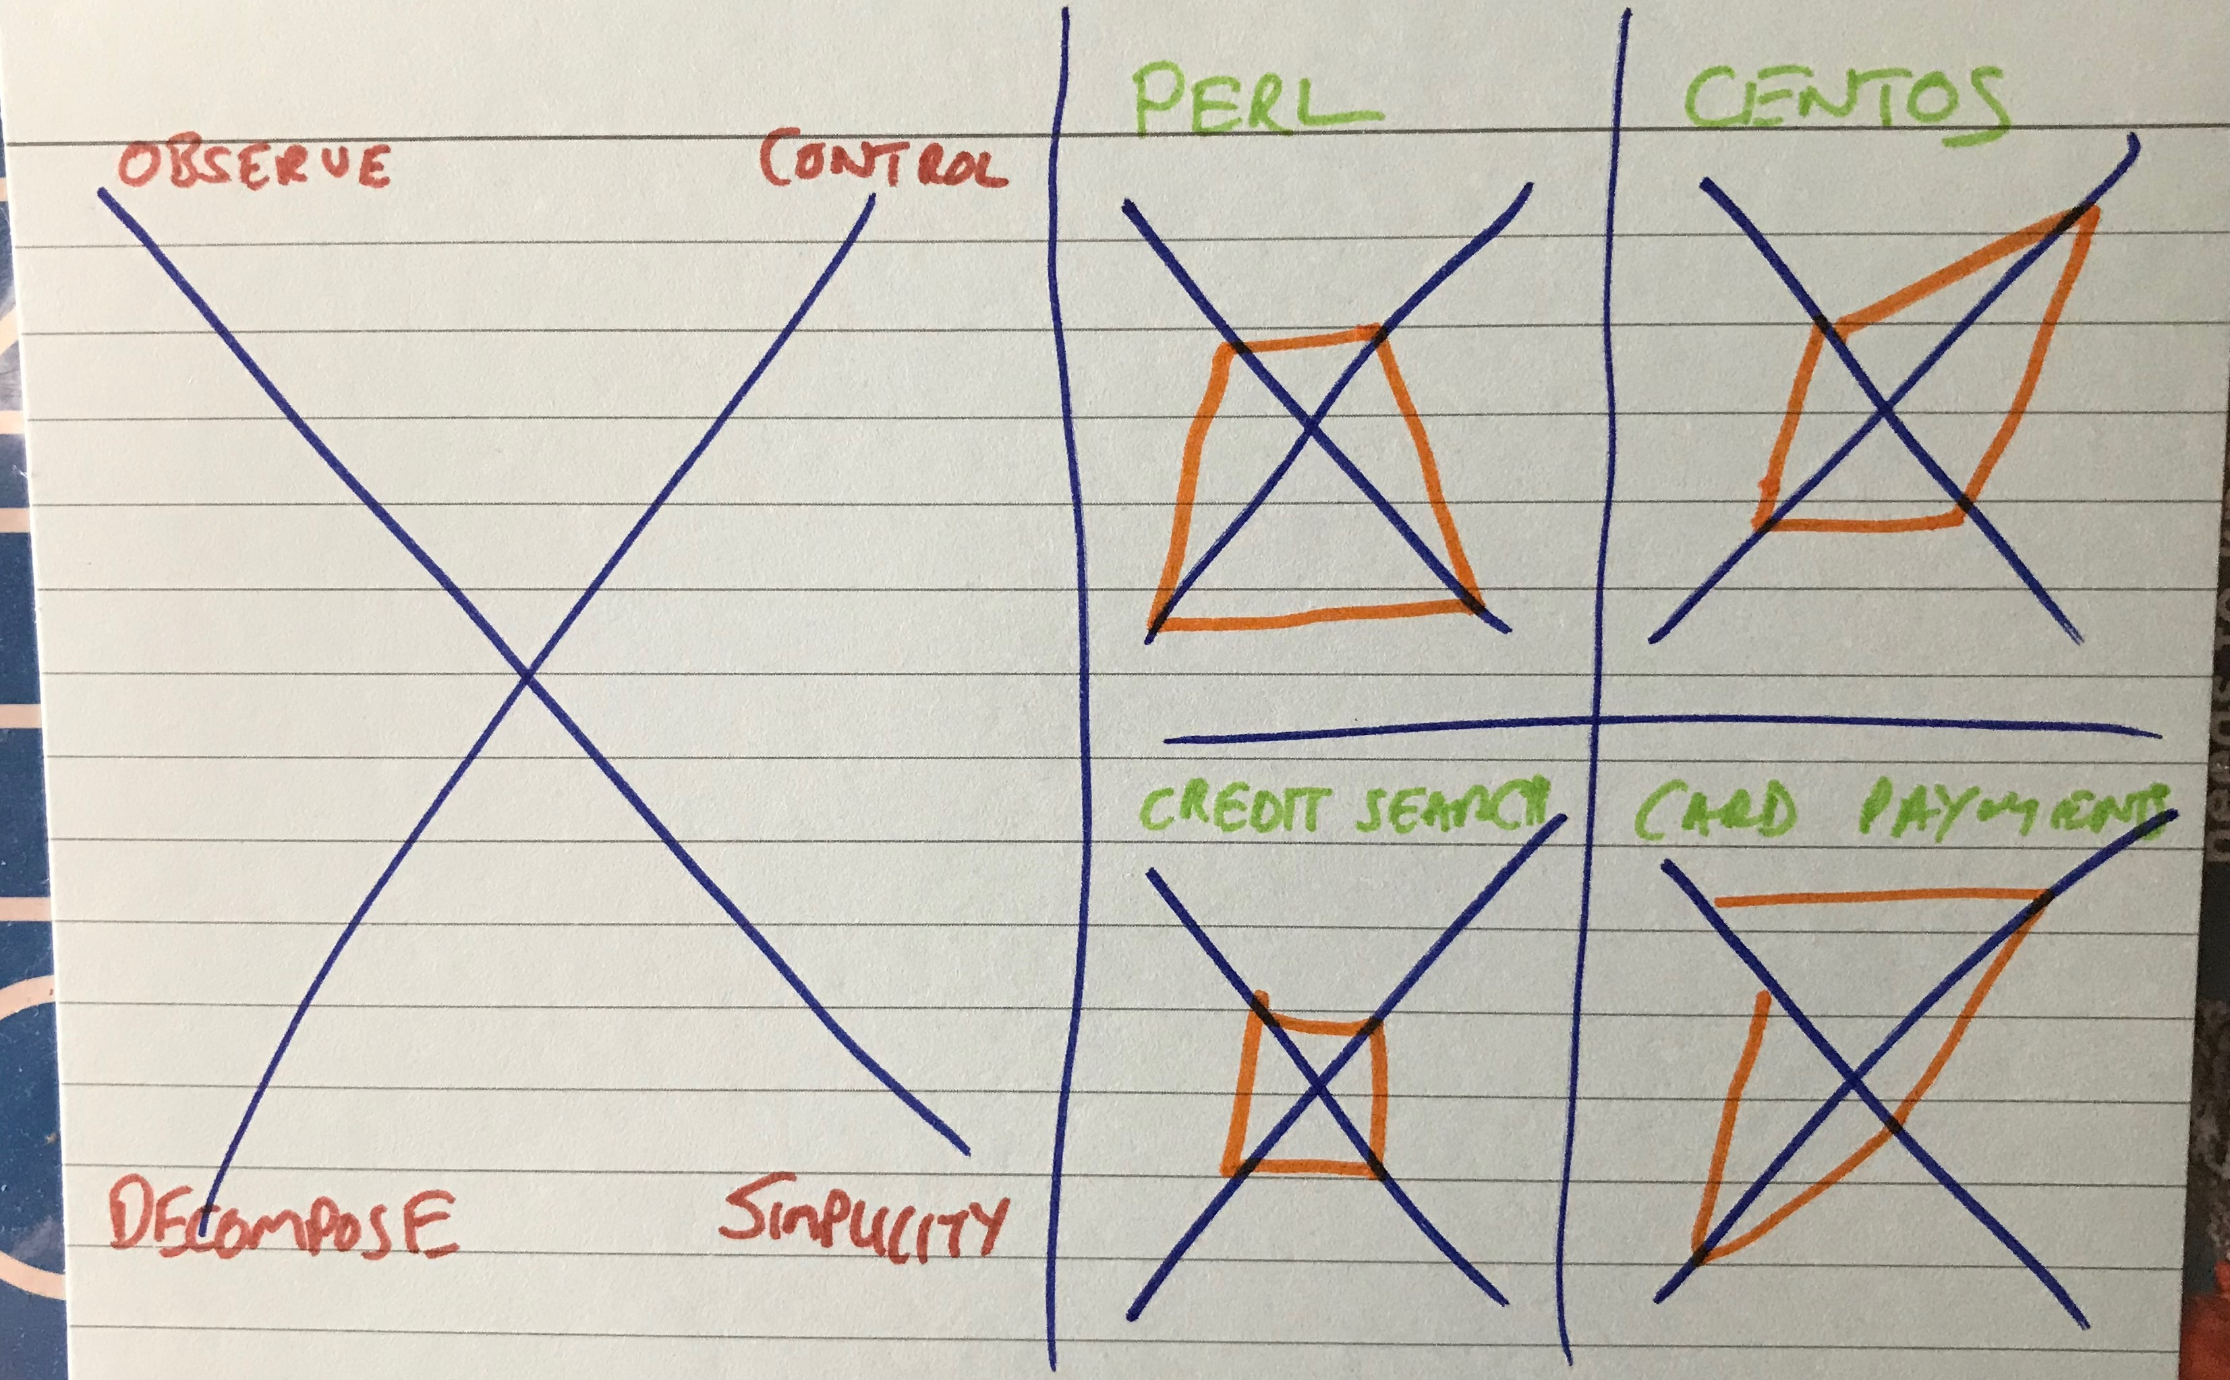
Dependencies Spider
For the dependencies in the handout, as a sample
Draw a spider diagram like the one shown above
Close to the centre is good, further out is bad
Add any more you from the system architecture
Reflect back

Slide 8
Layers and Interfaces
Testability varies from layer to layer
Clear interfaces enhances testability
FIBLOTS Handout

Slide 9
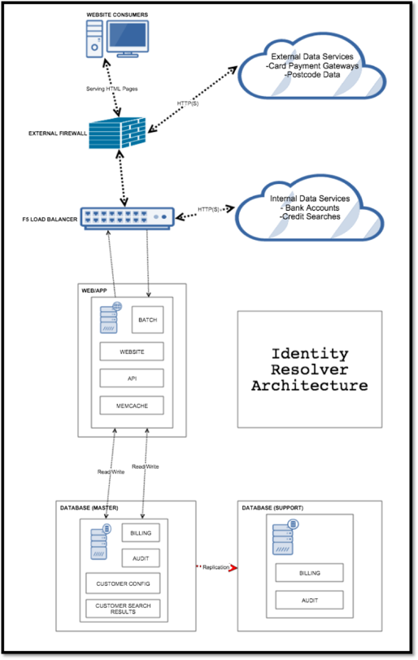
Layers and Interfaces
On a model of the architecture
Add risks for each layer and interface using the handout as a source of ideas
Reflect back
External service changes API contract
Interface
Layer
Corrupt Config Data

Slide 10
Now, Next, Later
Testability changes can be big!
Important to win early
With a vision for the future
Handout

Slide 11
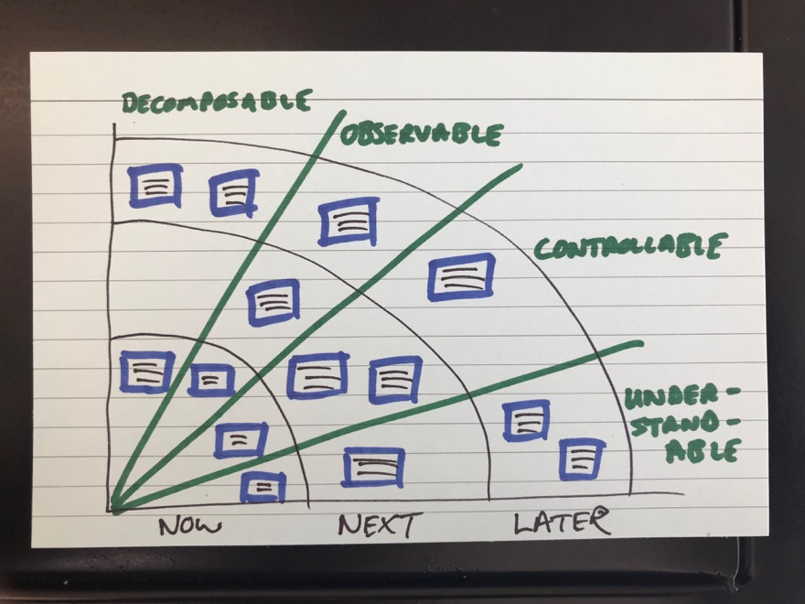
Now, Next, Later
Draw a chart like the one shown above
For each of the four key concept add an action(s) you would take now, next and later
Use the three previous exercises to inform your actions
Reflect back

Slide 12
Bring it all together
Adjacent Testability Targets – know where your testability limits and multipliers are
Dependencies Matrix – risk based view on that which you depend upon
Layers and Interfaces - understand risk within and between layers of your architecture
Now, Next, Later – a pragmatic vision for remedying some of the challenges

Slide 13

Summarise…
It’s me…
It’s you…

